Slide 1
Text to speech project
Group names :-
1-beshoy elbadry botrous
2-ramez farg soleman
3-ibrahim fahim
Under supervision:-
Dr.Khaled Hussein

Slide 2
Project description
This project explain how to convert Text to speech with SAPI and MSAgent ctrl.
The project offer to save the speech to wav file
The project will take Arabic language and will speak it.
We will make a database that have a table that have an English word and the opposite spoken word in Arabic

Slide 3
Tools Used
C# Program used to developing this Application.
Microsoft Speech API (SAPI) contains many interfaces and classes for managing speech. For TTS, the base class is SpVoice. The following are some important properties:
Voice Object of type SpObjectToken, which is inherited from ISpeechObjectTokens
Volume Integer specifies intensity of voice
AudioOutputStream specifies the stream for audio output; if you want to save it on file, use SpFileStream of SAPI
SynchronousSpeakTimeout specifies the milliseconds after which the voice's synchronous Speak and SpeakStream calls will time out

Slide 4
Program structure

Slide 5
Structure
Inorder to run the sample we need a set of APIs Installed in our system requirements
Speech SDK 5.1
MsAgent Control and Characters

Slide 6
Referencing the Speech API and MsAgent Control
Inorder to use the Speech API we need to reference it in our Application. This is done as follows.
make reference to the Microsoft Speech Library 5.0
find the reference of SpeechLib
We can add MSagent Control Directly to the Toolbar by selecting Add/Remove Items from Menu and selecting COM Component tab in the Customize toolbox Dialog

Slide 7
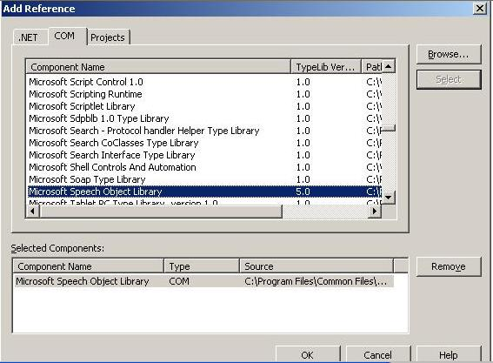
First we make reference to the Microsoft Speech Library 5.0 as follows

Slide 8
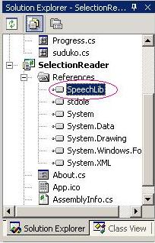
Now we can find the reference of SpeechLib

Slide 9
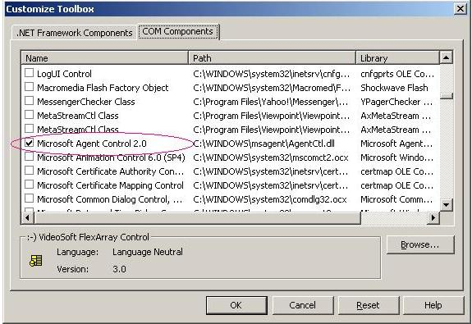
Now we have to reference MsAgent Control

Slide 10
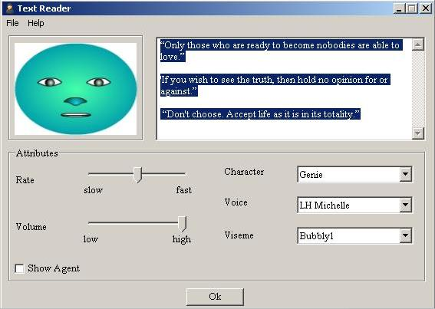
Program interface

Slide 11
methods
GetVoices() returns all available voices; I have use this to populate the voice-type comboBox
Speak() returns the audio on the output stream (speaker/ file)
Pause() pauses the audio output
Resume() resumes the audio output
WaitUntilDone() blocks application execution while a voice is speaking asynchronously

Slide 12
Using the code
To start with SAPI in your .NET application, you have to first add a reference to SAPI.dll from the path C:\Program Files\Common Files\Microsoft Shared\Speech if SAPI is not appearing in COM tab of Add Reference. Following is the code that generates audio based on the text entered. Note that I am assigning the Voice property a value based on the voice type selected from the combo box. At form_load, I have filled the combo box with all available voices. See the next code section.

Slide 13
<PRE lang=cs>Private Sub btnSpeak_Click(ByVal sender As System.Object,
ByVal e As System.EventArgs)
Handles btnSpeak.Click
Me.Cursor = Cursors.WaitCursor
Dim oVoice As New SpeechLib.SpVoice
Dim cpFileStream As New SpeechLib.SpFileStream
oVoice.Voice = oVoice.GetVoices.Item(cmbVoices.SelectedIndex)
oVoice.Volume = trVolume.Value
oVoice.Speak(txtSpeach.Text,
SpeechLib.SpeechVoiceSpeakFlags.SVSFDefault)
oVoice = Nothing
Me.Cursor = Cursors.Arrow
End Sub</PRE>

Slide 14
Find all available voices and then bind with Voice ComboBox by using the GetVoices() method on the SpVoice class object. Note the list of available voices. We can use the getDescription() method to find out the voice name, e.g. LH Michael.

Slide 15
<PRE lang=cs>Private Sub Form1_Load(ByVal sender As System.Object,
ByVal e As System.EventArgs)
Handles MyBase.Load
Dim x As New SpeechLib.SpVoice
Dim arrVoices As SpeechLib.ISpeechObjectTokens = x.GetVoices
Dim arrLst As New ArrayList
For i As Integer = 0 To arrVoices.Count - 1
arrLst.Add(arrVoices.Item(i).GetDescription)
Next
cmbVoices.DataSource = arrLst
End Sub</PRE>

Slide 16
To save the audio output to a file, you must use SpFileStream and set AudioOutPutStream equal to your stream object of type SpFileStream

Slide 17
<PRE lang=cs>If SaveFileDialog1.ShowDialog = Windows.Forms.DialogResult.OK Then
Dim oVoice As New SpeechLib.SpVoice
Dim cpFileStream As New SpeechLib.SpFileStream
cpFileStream.Open(SaveFileDialog1.FileName,
SpeechLib.SpeechStreamFileMode.SSFMCreateForWrite, False)
oVoice.AudioOutputStream = cpFileStream
oVoice.Voice = oVoice.GetVoices.Item(cmbVoices.SelectedIndex)
oVoice.Volume = trVolume.Value
oVoice.Speak(txtSpeach.Text, SpeechLib.SpeechVoiceSpeakFlags.SVSFDefault)
oVoice = Nothing
cpFileStream.Close()
cpFileStream = Nothing
End If</PRE>

Slide 18
Running the program write the text

Slide 19
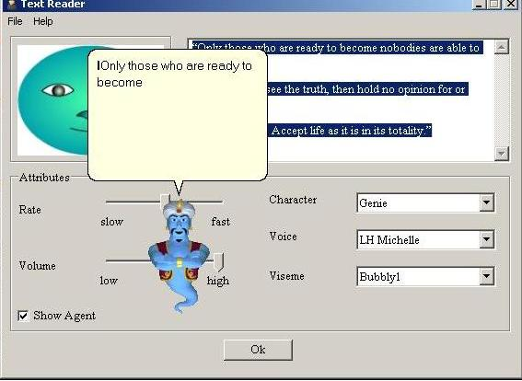
Hear the voice

Slide 20
THANKS
Thanks for everyone who help us in this project
DR.Khaled Hussein

